Slide 1
PROJECT BLH
By: Charles Sanvictores &
John David Solomon

Slide 2
Introduction
Company Profile
Binangonan Lakeview Hospital
Binangonan Lakeview Hospital Incorporated is a private corporation founded and registered with the Securities and Exchange Commission (SEC) in November 2011. A group of doctors and their friends had a vision to put up a healthcare facility in Binangonan, Rizal that will provide a high quality healthcare service for the community and nearby towns. Sixty (60) percent of the stakeholders are practitioners in the province who are specialists in their respective fields.
Construction of the hospital building situated in a 2, 158 square meter lot, took almost two (2) years, taking in consideration and strictly following all the Department of Health mandated requirements for a hospital facility.
BLH formally opened as a 30-bed capacity Secondary 2nd Level hospital on October 3, 2014 immediately after the issuance of DOH License to Operate (LTO). After three years, BLH is now an 88-bed capacity and has leveled up to a tertiary hospital.
At the moment BLH operates 24 hours, 7 days a week and an accredited partner of Philippine Health Insurance Company (PHIC).

Slide 3
Introduction
Mission
A community of professional healthcare providers advocating competent, ethical and compassionate healing.
Vision
We are the Pioneers, the Leaders of Quality healthcare service in the region
Core Values
Teamwork
Integrity
Professionalism
Service Excellence
Social Responsibility

Slide 4
Introduction
Services Offered
Medical and Surgical Clinics
Breast Care Clinic:
Mammogram / Breast Ultrasound
Dental / Panoramic X-ray
Obstetrics and Gynecology Clinics
Pediatric Clinics
ENT Clinic / Hearing Screening Test / Ophtalmology / Cataract Surgery
CT Scan / CT Guided Biopsies
X-ray and Ultrasound
Hemodialysis Center

Slide 5
Introduction
Services Offered
Pharmacy – 24hr. Service
Tertiary Laboratory – 24 hr. Service
Emergency Medical Services / Ambulance
Physical Rehabilitation Unit
Endoscopy Unit
Oncology Unit
Adult Intensive Care Unit
Neonatal Intensive Care Unit
Outborn Unit
Respiratory Therapy Unit
Memory Screening Test
2D Echo w/ Color Doppler
Diabetes and Nutrition Clinic
Animal Bite Center

Slide 6
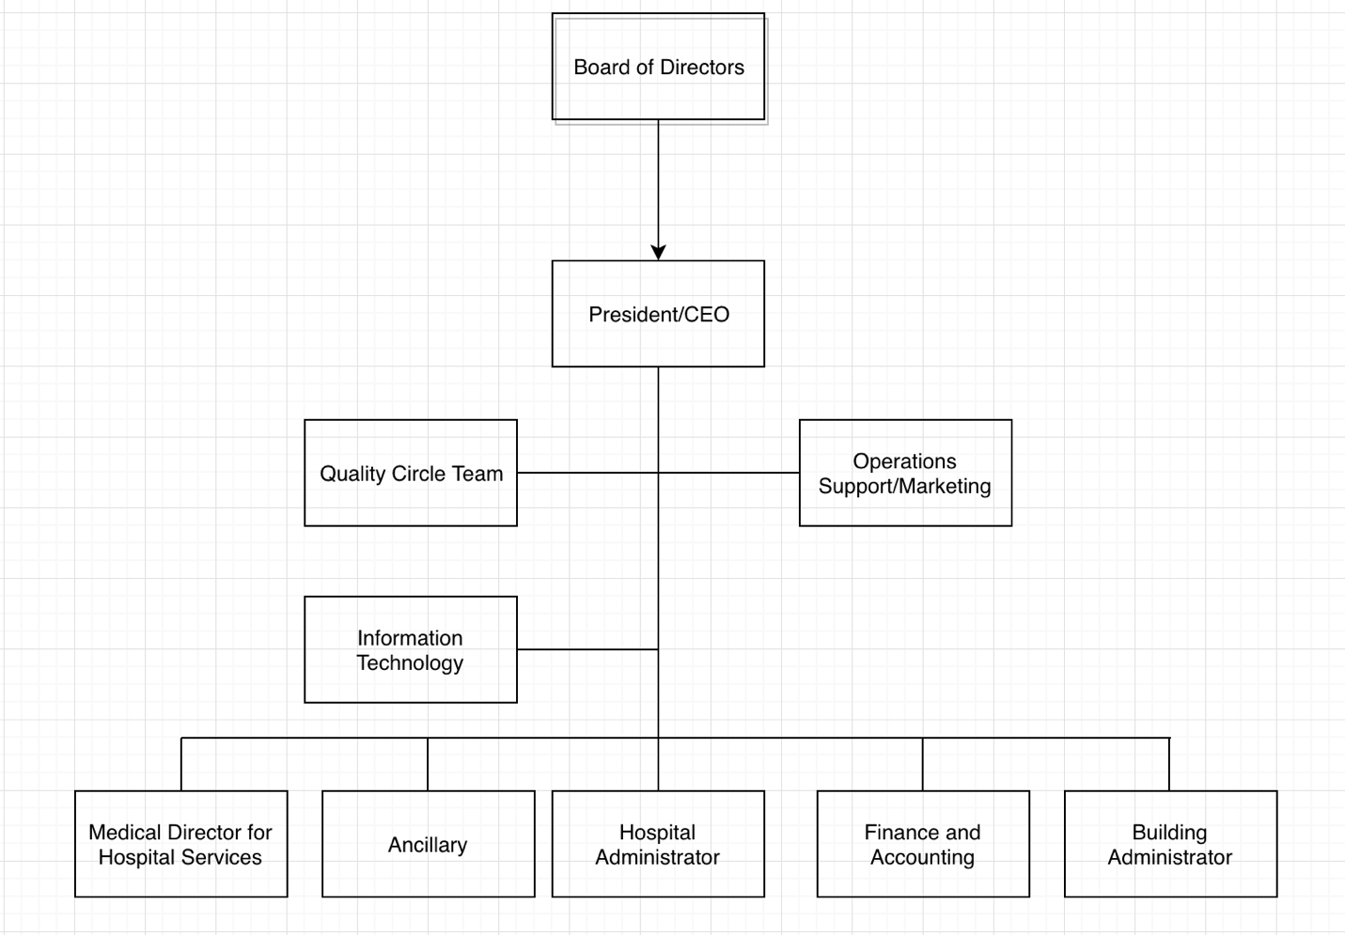
Organizational Chart

Slide 7
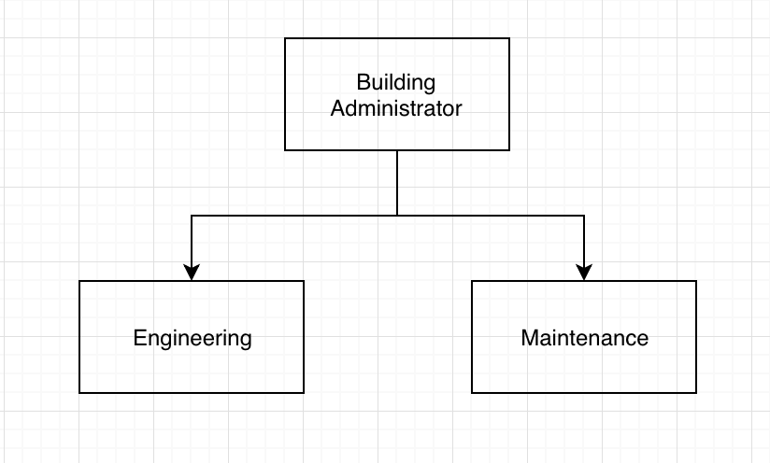
Department / Unit

Slide 8
Abstract
The hospital currently has a manual service request system that is not able to cope up with the demands of customers since 2014 based on the data they gathered. As the years go by, they have been looking for an IT personnel that can offer them an automated request system which can resolve some of the hospital’s issues like the inefficiencies, confusions and turndowns of the manual processed services because there are still unnecessary steps and paper dependent process that can only be remove once an automated request system is implemented at ther institution. This project proposal that the researchers are currently doing right now should be able to provide what they need. Our project proposal is based on real data gathered from the hospital.

Slide 9
Background of the Problem
Our client, Binangonan Lakeview Hospital is currently using a traditional manual process service request system, from the filling up of a request form, submitting it to the Building Administrator and getting signed authorization of service request/s from the department supervisors. The current system is inefficient and unreliable at most times especially when it comes to coping with multiple demands from various departments, varying shifts if maintenance personnel and when the service requested requires extended time for completion due to, delayed delivery of supplies, parts, etc. BLH’s current system causes confusion and/or turnover/s of service request because to be able to initiate a job, the maintenance personnel will have to be authorized by a department supervisor.

Slide 10
Statement of the Problem
The proposed system will be addressing the inefficiencies and additional steps and processes of the current manual service request system. There are a lot of service request/s which must be carried out daily and most of the time, even at night. Based on the recorded data by the hospital, since the processes of the current manual service request system is very inefficient, the maintenance department is unable to cope with the demands of various departments, such as for example, Cardiology and Radiology. The two departments were unable to perform their duties because the machines namely the X-ray and ECG are both faulty and/or damaged and where not repaired on time. This issue caused delays and inefficiencies in the delivery of services of the said departments, effectively diminished the trust and confidence of the patients who are in need if the said services. BLH suffers and losses in terms of profits and prominence in offering high quality service whenever an inconvenience happens just because their service request system is still manually processed. The manual system is becoming obsolete and can’t cope with today’s current demand because of many factors like the rapid increase of population, urbanization in the area, new diseases and many more, so, the researchers proposed PROJECT BLH. An automated Service Request Management System capable of meeting today’s demands with ease of usage and efficiency. It only requires a PC with internet connection for the system’s actors namely, Department Supervisor, Admin or Building Admin, and the Maintenance Personnel to be able to communicate to each other without the need of physical interaction and papers. Project BLH is based on Structured System Analysis and Design Method (SSADM).

Slide 11
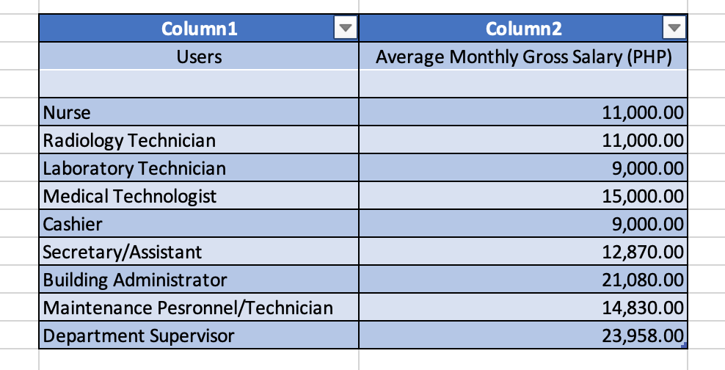
PRESENT SYSTEM
Users of Present System
Note: Some of the given average Monthly Gross Salary were roughly estimated by the company representative of the hospital as this particular subject is confidential.

Slide 12
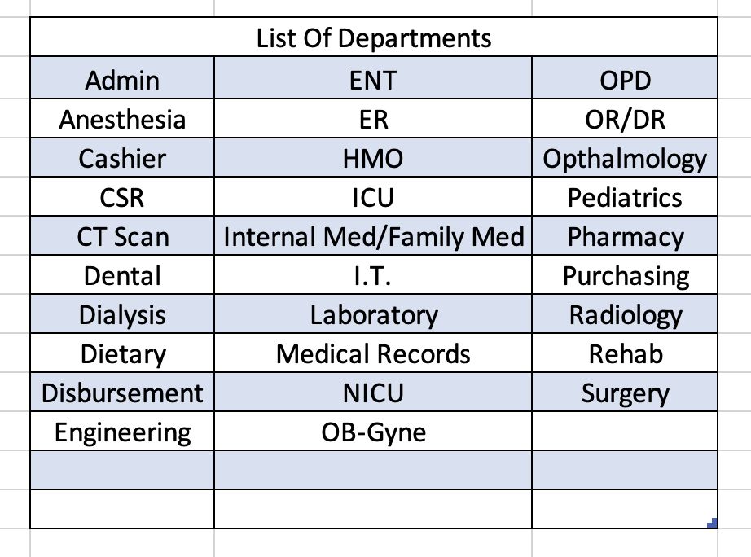
List of Departments and Venues of the Present System
Note: The departments that are listed are provided by the Admin.

Slide 13
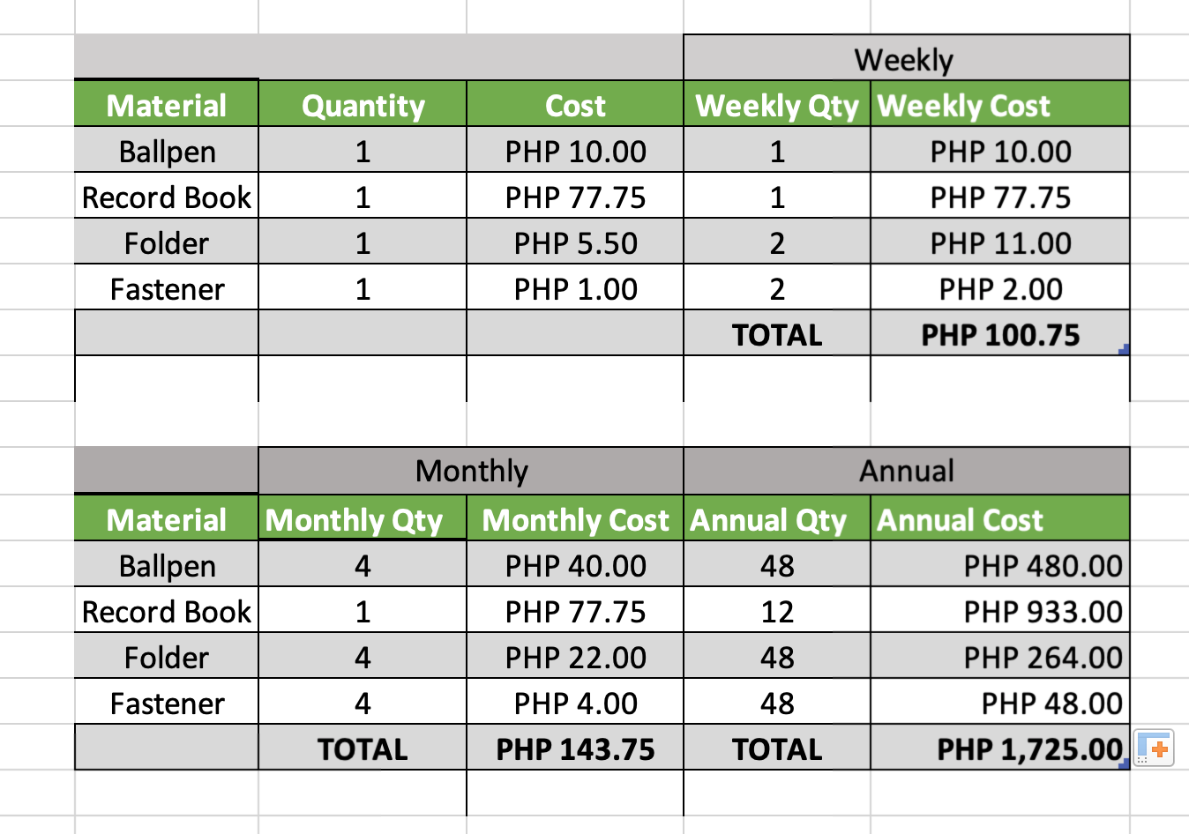
Material Cost of the Present System

Slide 14
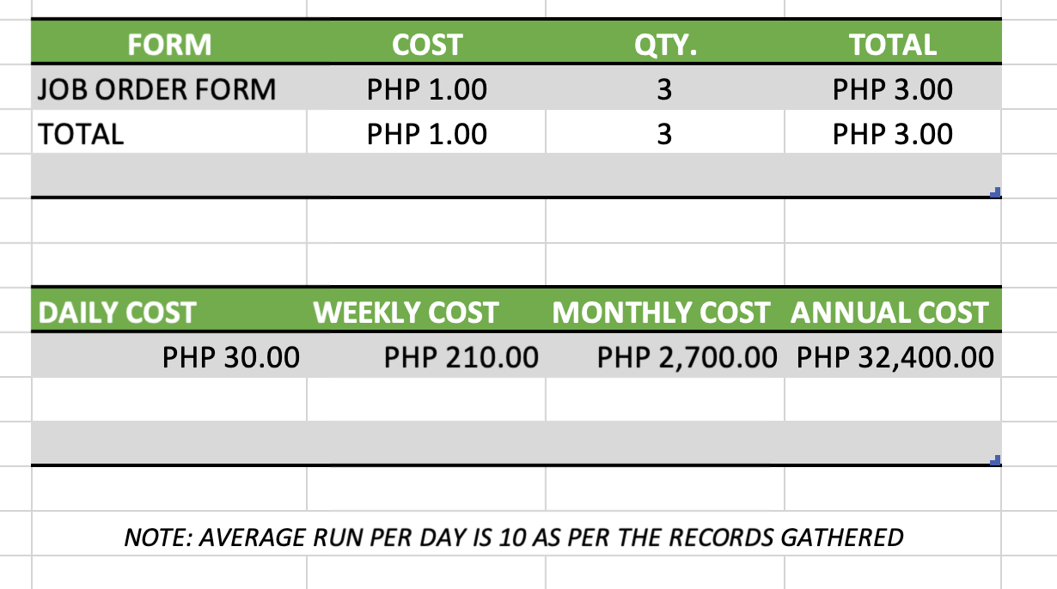
Form Cost of the Present System

Slide 15
Objectives
Main Objectives
The main objectives of BLH is to automate the processing of service request across the 30 departments who uses the current system.
Specific Objectives
To monitor/track all maintenance service request/s from various departments
To make the process efficient and faster
To avoid loss and to cover more jobs needed

Slide 16
Scope and Limitation
The Project BLH Service Request Management System shall cover maintenance service request/s.
Based on the data provided by the Hospital, the proposed Service Request Management System will be subject to the following limitations:
There will be 3 types of Requests:
Replace Request
Repair Request
Item Request
There will be 3 users of the System:
Admin
Maintenance Personnel
Department Supervisor

Slide 17
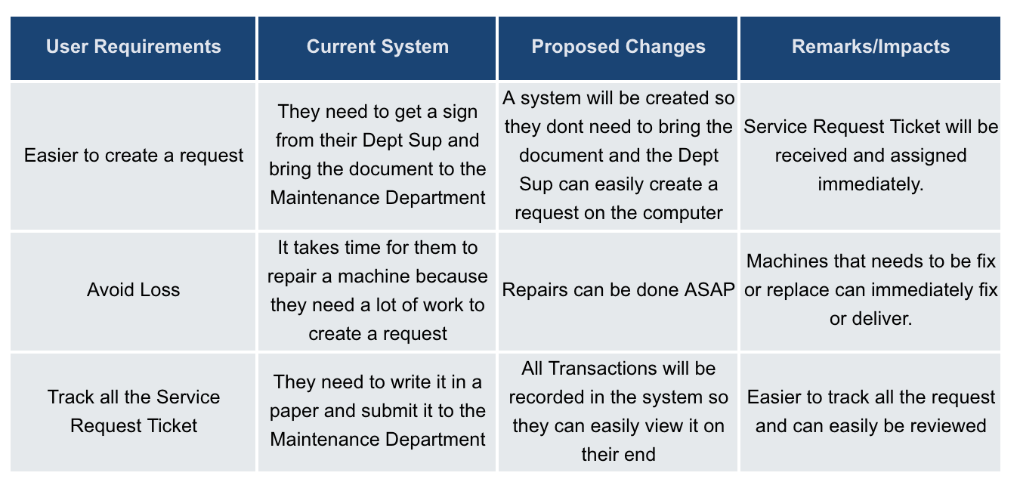
Gap Analysis

